Slide 1


The Key to Happiness
By Veronica Warren

Slide 2
Background
According to the World Health Organization, 5 percent of people worldwide live with depression and 75 percent of those people do not get treatment. Prior to the Covid pandemic depression was the leading cause of disability. After the pandemic, those percentages worsened. To lower these rates, we need strategies that will help increase positivity and happy emotions.
What is happiness? Getting a better understanding of what happiness is could help understand how to assist our patients in achieving it. Happiness is an emotional state that is characterized by feelings of joy, satisfaction, contentment, and fulfillment. Certain things like genes play a role of your overall happiness. Another factor that plays a roll in happiness is the choices people make. Some of the happiest places worldwide are Finland, Denmark, Switzerland and Iceland are amongst the happiest countries in the world.

Slide 3
Business Problem
My company is a nonprofit mental health company that would like to increase the overall happiness in our patients. To do this we measured 6 factors that contribute to overall happiness in countries worldwide. We measured each factor against the happiness score to find out which make up the happiest countries.

Slide 4
Data Explanation
One dataset I have collected is from Kaggle. It includes data taken from different countries in the world and measures individuals feelings in regards to variables like generosity, and political views..
The other data set is from the World Happiness Report of 2022 which includes factors such as freedom to make choices and social support. I have compiled the data and condensed it to focus on the top 15 happiest countries. After collecting the data needed, I compared the variables against happiness score to see what the correlation is, thus finding the best variables that increase happiness.

Slide 5
Methods
I will be pulling information from the World Happiness Report. On this report it gives data on the top countries overall happiness levels are. There are other datasets that I retrieved data from that provide variables I will be using to find any correlation within these countries.

Slide 6
Analysis
After analyzing the data I found that Social Support had the highest correlation with happiness at 0.68, freedom to make life choices had a 0.63 correlation. Healthy life expectancy and Perception of corruptions came in 3rd and 4th with Healthy life expectancy having a 0.32 correlation with happiness and Perception of corruptions having a 0.27 correlation.

Slide 7

Conclusion
After analyzing data from the World Happiness report, the data shows that there are two factors that play a significant role in happiness. The factors are social support and the freedom to make your own decision. Some other factors that are proven to scientifically contribute to happiness are said to be Gratitude and giving back. Gratitude is appreciating and being grateful for things in your life.
Some ways we can show more gratitude is by doing simple things such as making eye contact with the person you have a conversation with. This shows that you are present in the moment.
We can also think of several things in the morning to be grateful for.
Lastly, Giving back is another way people feel happier. It falls into the realm of generosity. Some ways people can give back is to teach a skill, volunteer in their community and give food to those in need.

Slide 8
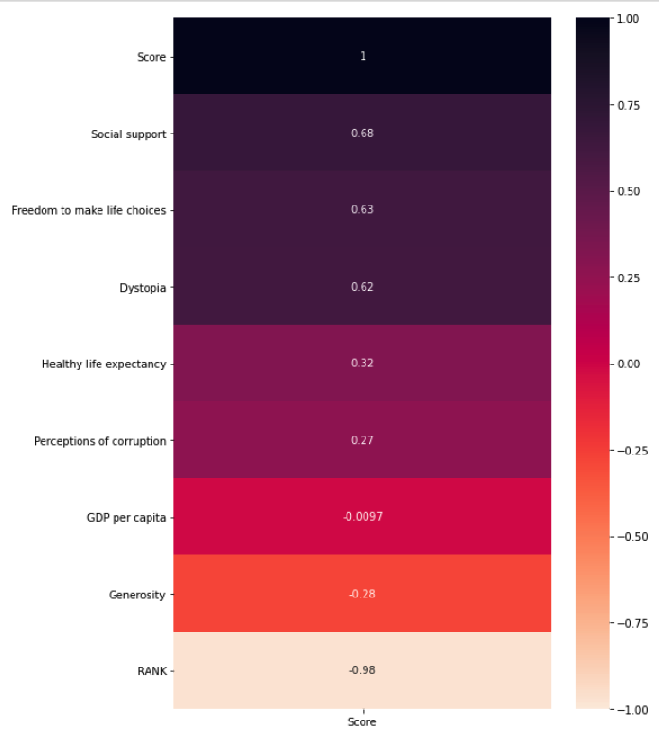

Slide 9
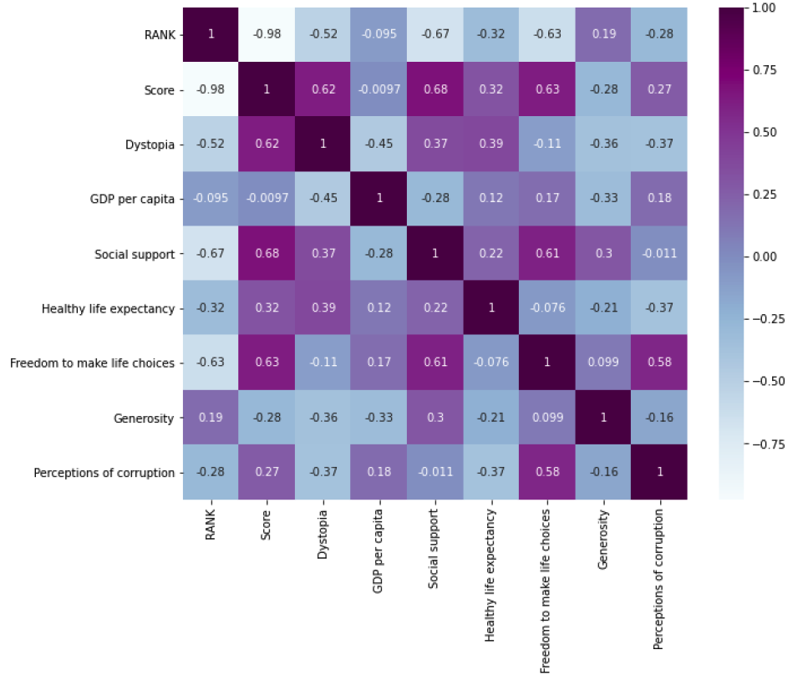

Slide 10
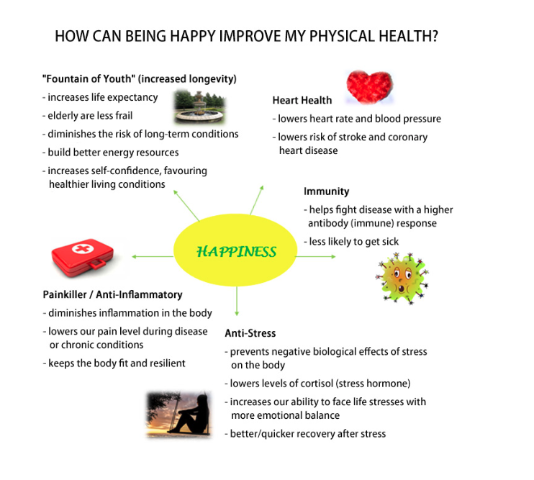

Slide 11
Q & A
1. What is Dystopia and why is it included in the Happiness Report
2. What are the top factors that make people happy?
3. Do genetics play a part in happiness?
4. Are there foods that can assist in happiness?
5. Does exercise assist with happiness?
6. Is there a routine that happier people partake in?
7. Does sleep assist in one’s happiness?
8. How has covid impact people’s overall happiness
9. How to overcome depression?
10. What will the prospects for happiness in the future depend on?

Slide 12
Thank you!

